Slide 1

Testing and Verification (CSC7056/CSC3056)
Aidan McGowan
Static Analysis by Tools

Slide 2

Tools used for static analysis
Typically used by the developers before and sometimes during component and integration testing.
Also used by the designers during software modelling.

Slide 3
Static Analysis by Tools
The Compiler can be considered as a static analysis tool because it builds a symbol table, points out incorrect usage and checks for non-compliance to coding language conventions or syntax.
There are other various static code analysis tools which are common in day to day use.
Notes:
In computer science, a symbol table is a data structure used by a language translator such as a compiler or interpreter, where each identifier in a program's source code is associated with information relating to its declaration or appearance in the source, such as its type, scope level and sometimes its location.
Contents
1 Implementation
2 Uses
3 Example
4 See also
Implementation
A common implementation technique is to use a hash table. A compiler may use one large symbol table for all symbols or use separated, hierarchical symbol tables for different scopes. There are also trees, linear lists and self-organizing lists which can be used to implement symbol table.It also simplifies the classification of literals in tabular format.
Uses
An object file will contain a symbol table of the identifiers it contains that are externally visible. During the linking of different object files, a linker will use these symbol tables to resolve any unresolved references.
A symbol table may only exist during the translation process, or it may be embedded in the output of that process for later exploitation, for example, during an interactive debugging session, or as a resource for formatting a diagnostic report during or after execution of a program.
While reverse engineering an executable, many tools refer to the symbol table to check what addresses have been assigned to global variables and known functions. If the symbol table has been stripped or cleaned out before being converted into an executable, tools will find it harder to determine addresses or understand anything about the program.
At that time of accessing variables and allocating memory dynamically, a compiler should perform many works and as such the extended stack model requires the symbol table.[further explanation needed]
Example
Consider the following program written in C:
// Declare an external function
extern double bar(double x);
// Define a public function
double foo(int count)
{
double sum = 0.0;
// Sum all the values bar(1) to bar(count)
for (int i = 1; i <= count; i++)
sum += bar((double) i);
return sum;
}
A C compiler that parses this code will contain at least the following symbol table entries:
Symbol name Type Scope
bar function, double extern
x double function parameter
foo function, double global
count int function parameter
sum double block local
i int for-loop statement
In addition, the symbol table will also contain entries generated by the compiler for intermediate expression values (e.g., the expression that casts the i loop variable into a double, and the return value of the call to function bar()), statement labels, and so forth.

Slide 4
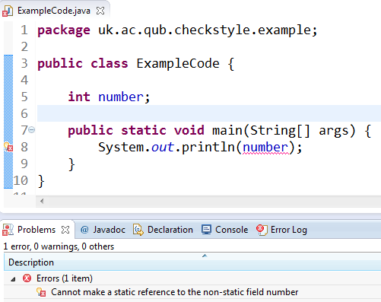
Compiler
Non-compliance to coding language conventions or syntax.

Slide 5
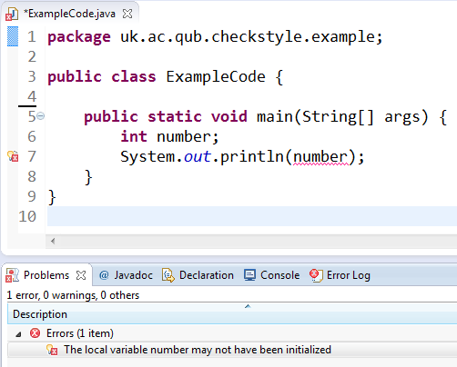
Compiler
Non-compliance to coding language conventions or syntax.

Slide 6
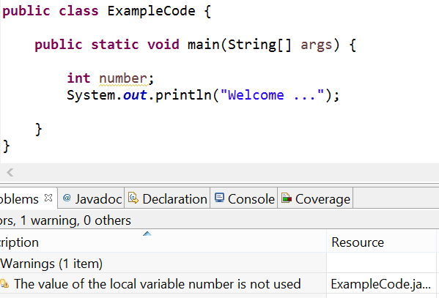
Compiler
Warnings….

Slide 7
Static Analysis by Tools –
Coding standards
A Coding Standard consists of a set of programming rules, naming conventions.
There are many standards, usually a software development company will have their own version. For example …
  Classes should start with capital Letter
  Layout specifications (e.g. Indent 4 spaces towards right).

Slide 8
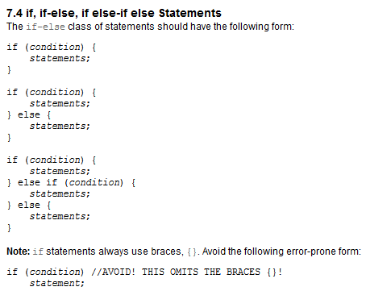
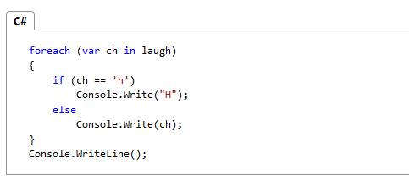
Coding standards - example
Oracle - Java coding guidelines
Microsoft – c# coding guidelines

Slide 9
Why enforce coding standards ?
Code conventions are important to programmers for a number of reasons:
  80% of the lifetime cost of a piece of software goes to maintenance.
  Hardly any software is maintained for its whole life by the original author.
  Code conventions improve the readability of the software, allowing engineers to understand new code more quickly and thoroughly.

Slide 10

Enforcing a standard
The main advantage of this is that it saves lots of effort.
The added advantage with well-known coding standards there are many automated checking tools available that support that standard. (Checkstyle, Code Style Enforcer, PHP_CodeSniffer).
Most can be integrated into IDEs as plugins etc.

Slide 11
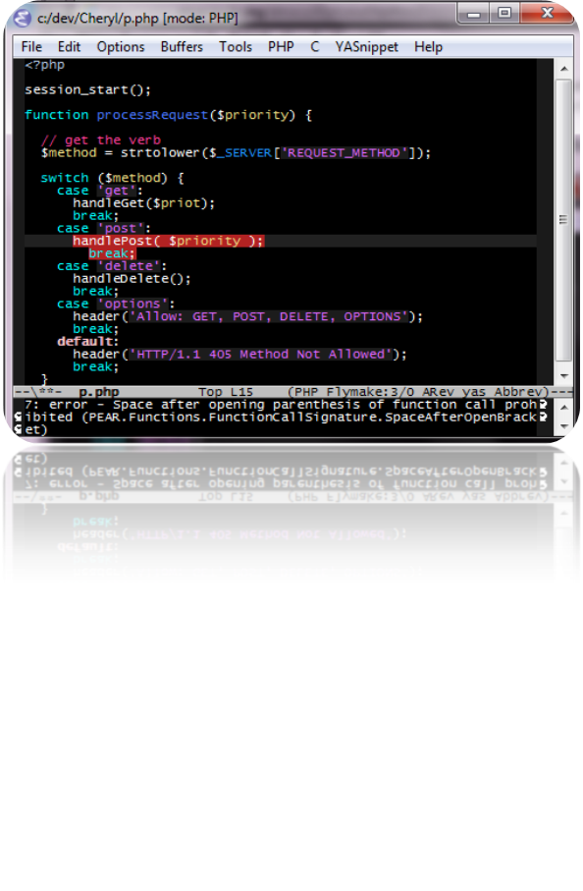
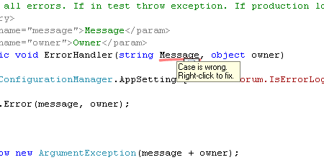
Enforcing a standard
Code Style Enforcer
PHP_CodeSniffer

Slide 12
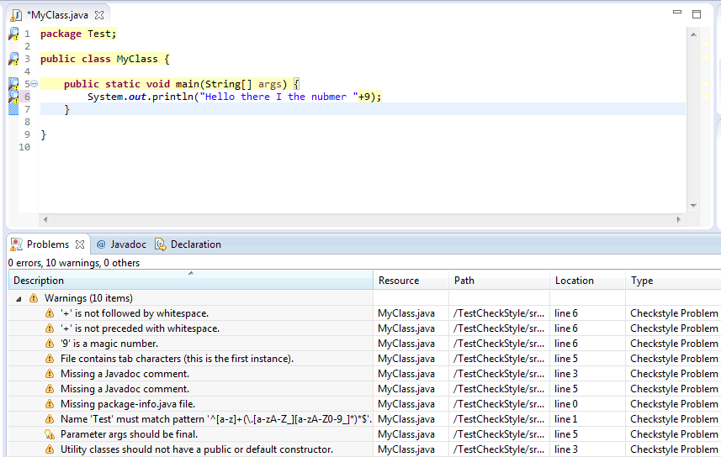
Checkstyle demo

Slide 13

Non automated - checking
Without automated tools the enforcement of coding standards in an organisation is likely to fail …
  The number of rules in the coding standard is so large that nobody can remember them all.
  Makes the review process less effective. If developers are spending time checking coding standards in reviews it will distract from other defects that might otherwise find.

Slide 14

Static Analysis by Tools –
Coding metrics
The measurement of :
  depth of nesting
  cyclomatic number
  number of lines of code.

Slide 15
Coding Metrics – why and when
Information from metrics can be computed not only as the design and code are being created but also during the changes that are made to the system, to see if the design or code is becoming bigger, more complex and more difficult to understand and maintain.
The measurement also helps us to decide between several design alternatives.

Slide 16
Metrics used …
There are several different types of structural measures.
  Cyclomatic complexity
  Code structure
    Control flow structure
    Data flow structure
    Data structure

Slide 17
Cyclomatic complexity
The Cyclomatic complexity metrics is based on the number of decisions in a program.
Important for testing because it provides an indication of the amount of testing.
There are many ways to calculate cyclomatic complexity but the easiest way is to sum the number of binary decision statements (e.g. if, while, for, etc.) and add 1 to it.

Slide 18
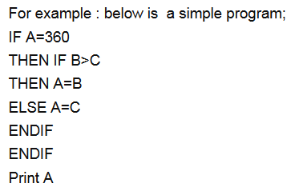
Cyclomatic complexity
2 IF conditions.
To calculate the Cyclomatic complexity add 1 to the number of IF conditions and the cyclomatic complexity is 2+1=3.

Slide 19
Exercise - Cyclomatic complexity
(assuming numbers are different)
IF A>B
THEN IF A > C
THEN BIGGEST =A
ELSE IF B>C
THEN BIGGEST = B
ELSE BIGGEST =C
Notes:
3 IF conditions therefore Cyclomatic complexity : 3+1=4

Slide 20
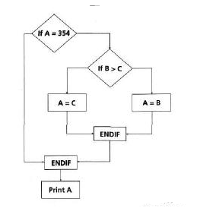
Cyclomatic complexity – control flow
We can also calculate the cyclomatic complexity using the control flow.
In the control flow shown there are 7 nodes (shapes) and 8 edges (lines).
Thus by formula ((no. of edges-no. of nodes)+2)
that is
(8-7)+2 = 1+2 = 3.

Slide 21
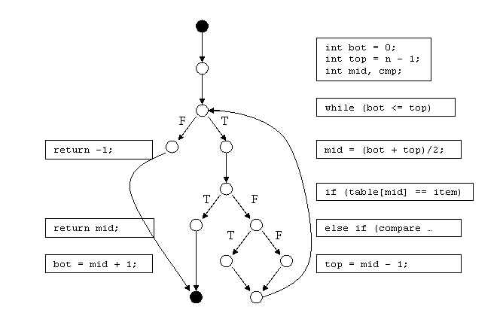
Exercise - Cyclomatic complexity – control flow
Notes:
CC = number of edges – number of nodes + 2
CC = 14 – 12 + 2
= 4
Simplified :
CC = number of decision point + 1
= 3 + 1
= 4

Slide 22
Cyclomatic complexity
White or Black Box testing ?

Slide 23
Static Analysis by Tools –
Coding structure
Code structure:
Information on the effort required to write the code in the first place, to understand the code while making the change, or to test the code using particular tools or techniques.
There are several aspects of code structure to consider:
  Control flow structure: It addresses the sequence in which the instructions are executed.
  Data flow structure: It follows the track of the data item as it is accessed and modified by the code.
  Data structure: It refers to the organisation of the data itself, independent of the program.

Slide 24
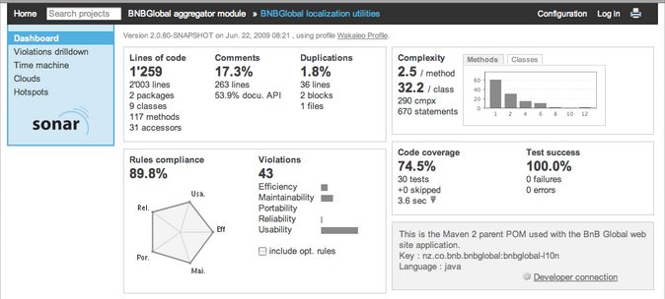
Automated Metric Tools

Slide 25
Exam Questions

Slide 26
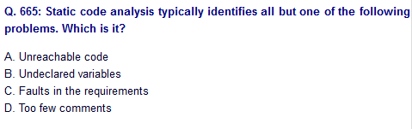
Notes:
C

Slide 27
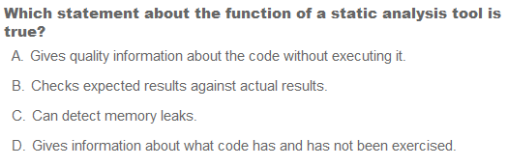
Notes:
A

Slide 28
Which of the following are defects discovered by static code analysis?
referencing a variable with an undefined value
Unreachable code
Number of lines of comments
Programming standards violations
Syntax violations
I, II, III
I, II, IV, V
III, IV, V
IV, v
All
Notes:
E

